Slide 1
Fundamentals of Information Technology and Networking
Networking 191 Final Project
By: Rashelle Stiltner

Slide 2
Week one - Project preparation :
This week was about gathering all hardware needed to complete the projects.
Hardware Included:
1. The Mango Travel Router
2. USB Power Cable
3. The Network Cable

Slide 3
Software Preparation:
The next step in preparation process is to download and install all software needed.
These Include:
Installing VM Ware Workstation Player
Ubuntu Virtual Machine

Slide 4
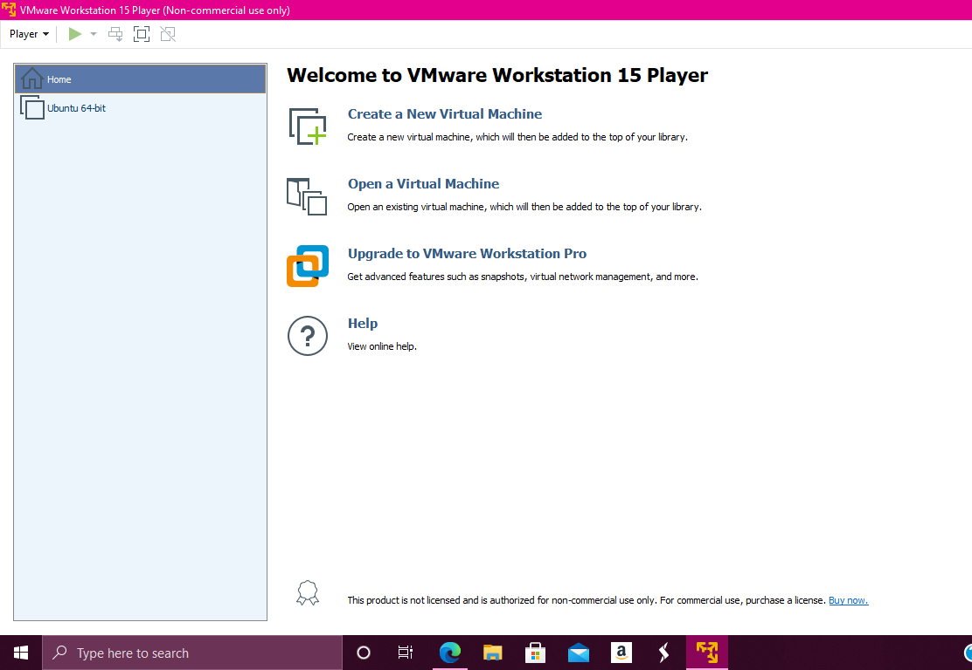
VM Ware Workstation:

Slide 5
Ubuntu Virtual Machine

Slide 6
Week Two: IPv4 and ipv6 Addressing
This week I learned to configure and assign IPv4 and IPv6 addresses to the travel router.
The first thing to do is configure the IPv4 address.
This is done by connecting the router into your computer and connect to the website associated with the router and if not already setup select language and sign in.

Slide 7
IPv4 continued …
Once you are signed in on the left panel there is menu options, on the bottom you will see More Settings. In the dropdown menu click on Advanced. On the next screen you enter your password.
Next you click on the Network heading and then Interfaces. In the IPv4 address bar enter: 192.168.105.1 and click save and apply. Next you will see that the configuration has been applied.
If you get disconnected it is because it has been changed and it is still attempting to communicate with old address. Simply exit out and this time in the search bar enter 192.168.105.1 and enter your password and you will see changes.

Slide 8
Windows Command Prompt
On the bottom of the screen there is a search bar. Within it enter command prompt and press enter.
In the screen that pops up enter ipconfig and press enter
This displays the list of newly assigned address information:
New IPv4 address: 192.168.105.167
Subnet Mask: 255.255.255.0
Default Gateway: 192.168.105.1

Slide 9
Screenshot of Information changes

Slide 10
Part 2 – Configuring ipv6 address:

Slide 11
To do this you follow the same steps as in part 1. Until you click Network and Interfaces headings in the drop-down menu.
At the bottom of the page, you will see Global Network options and in the IPv6 ULA-Prefix enter: 2003:dad:be::/48 and click save.
In the LAN section click edit. In the IPv6 assignment link bar change so reads: 64.
IPv6 assignment hint enter: 1::
In IPv6 suffix enter ::1 and at bottom of page click save and apply.

Slide 12
IPv6 Address Assignment of the Travel Router
This screenshot should include the following.
IPv6 address
IPv6 prefix

Slide 13
IPv6 Address Assignment of the Travel Router
This screenshot should include the following.
IPv6 address
IPv6 prefix

Slide 14
Week 3 Virtual Machine (VM) Dynamic IP Assignment

Slide 15
Objective:
In this part of the project, we needed to configure VMWare environment to support bridging so that Ubuntu would connect through the host’s NIC to the LAN of the travel router. This would allow the both of them to receive IP condigurations from the travel router.
First step was to bridge the Ubuntu. Turn off WIFI and start the VMWare workstation player. Highlight Ubuntu and click edit VM settings.
On the next screen click on network adapter in hardware column, select the bridged button and click ok.

Slide 16
Screenshot of Bridged VM

Slide 17
Part 2: Dynamic IP Assignment

Slide 18
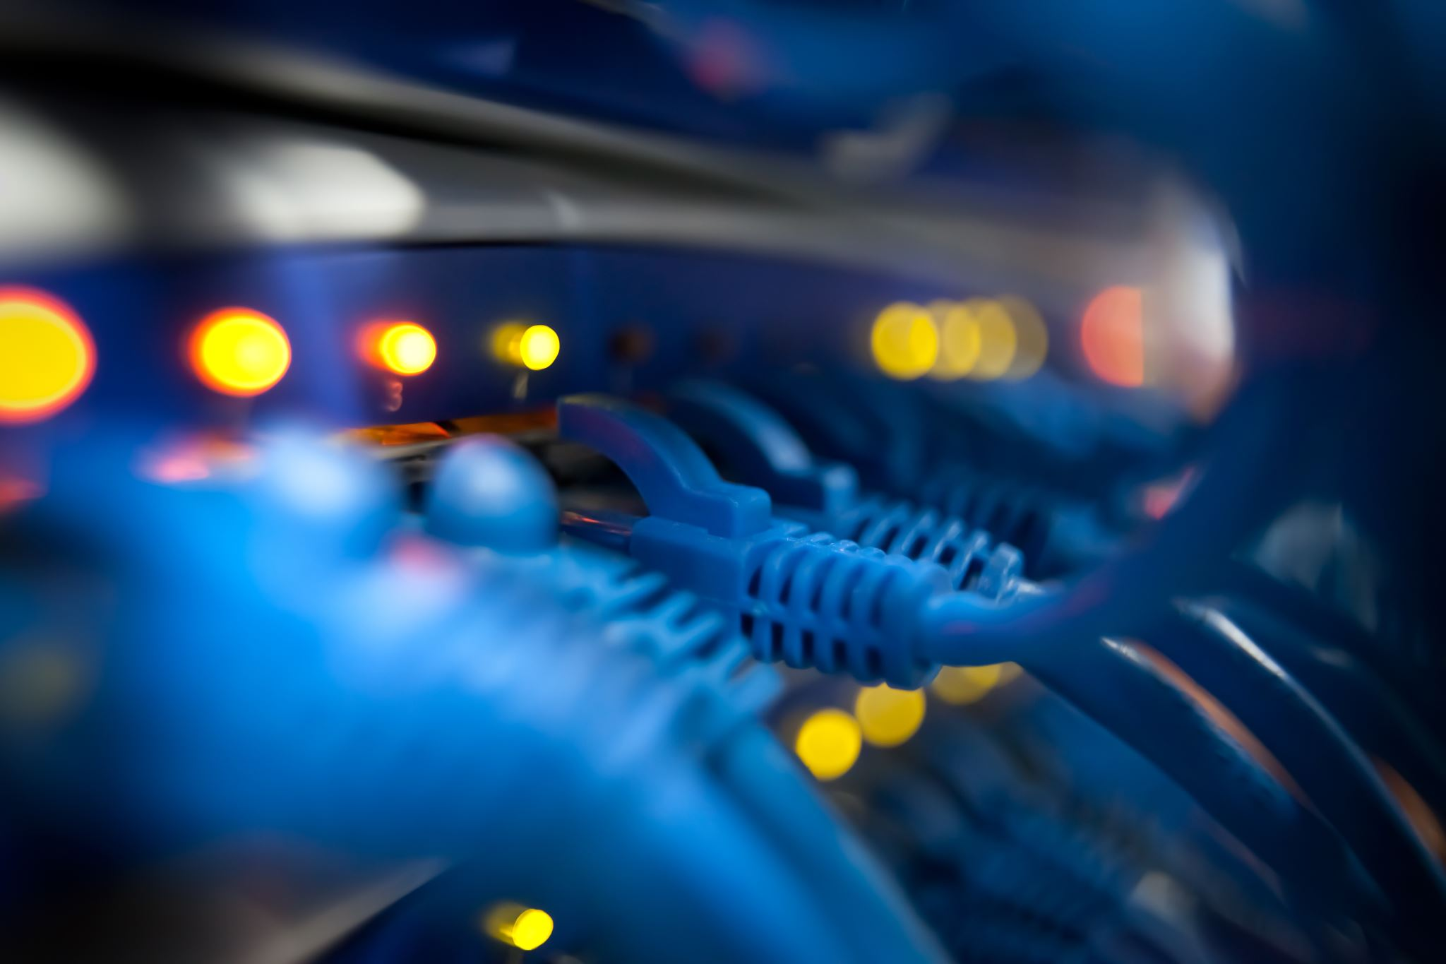
Bridged mode makes it possible for the Ubuntu VM and the host to be on the same physical network as the travel router.
- The travel router acts as the DHCP server
- The ethernet port of the host computer, Ubuntu VM, and the LAN of the travel router will have IPv4 and IPv6 addresses on the same network

Slide 19
Ip Address Assignments
In cmd windows command prompt, enter ipconfig and press enter.
Next, open the Ubuntu and login. Then right click and chose Open Terminal.
In the window enter ip addr and press enter. The information displayed inet is the IPv4 address and the inet6 is the IPv6 address assignments.

Slide 20
Host Computer Dynamic IP Assignment:

Slide 21
Week 4 Connectivity Test and Visio Network Diagram

Slide 22
Connectivity Tests:

Slide 23
The vNIC of Ubuntu VM and the ethernet adapter of the host computer are bridged, Ubuntu gets IP addresses directly from the travel router.
By using ping we tested to verify the network connectivity between all of them.

Slide 24
Steps Taken:
First make sure that airplane mode is on to temporarily turn off WIFI.
Launch VMWare Workstation Player and Ubuntu VM
Open a Windows command prompt window to view the IP addresses of the host computer.
In the command prompt window enter: ping 192.168.105.115 and if no packages were lost it was successful. Next enter ping 2003:dad:be:1:1fc:7b77:2f5d:4986
This tested the connectivity to the Ubuntu VM and test was successfully completed.

Slide 25
Ethernet adapter ping tests
Screenshot 1: Ubuntu VM connectivity
Screenshot 2: Travel router connectivity

Slide 26
Now we are going to ping test in the terminal window of the Ubuntu VM and perform connectivity tests to the host computer.
In the terminal window enter ping -c 4 192.168.105.167 and then entering ping -c 4 2003:dad:be:1:682b:8479:946b:4e26
Then do the same to test the connectivity to the travel router. Again, in terminal window enter ping -c 4 192.168.105.1 and then enter ping -c 4 2003:dad:be:1::1

Slide 27
Ubuntu VM ping tests
Host Computer:
Travel Router:

Slide 28
Microsoft Visio Network Diagram

Slide 29
Week 5: IP Subnetting and Loopback Interfaces

Slide 30
IP Subnetting
A host requires a unique identifier aka an IP address to function on an IP network
The identifiers are assigned and used as blocks of consecutive IP addresses.
While physical networks can be both physically and logically divided into subnets, address blocks need to divided into smaller blocks as well.
This allows accommodation for number of addresses required by a subnet.
Note not all IP addresses will be used by a host

Slide 31
Calculating a Subnet Table
The first subnet of an IP address is the subnet itself
Routers use that address in their routing tables to reach that subnet
The last IP address of the block is the broadcast where packets are sent to reach all hosts on the same subnet.
Addresses between these two are usable addresses that can be assigned.
The range between these two extremes are the usable addresses that can be assigned.

Slide 32
Subnetting Table:
This table should include two /25 subnets, including the network address, first usable host address, last usable host address, and broadcast address for each subnet.
 | Subnet notation (x.x.x.x/x) | Network address | First usable host address (1st IP address | Second usable Host address (2nd IP address) | Broadcast address (last IP address)
The first subnet | 192.168.5.0/25 | 192.168.5.0 | 192.168.5.1 | 192.168.5.126 | 192.168.5.127
The second subnet | 192.168.5.128/25 | 192.168.5.128 | 192.168.5.129 | 192.168.5.254 | 192.168.5.255

Slide 33
Loopback Interfaces on the travel router:

Slide 34
A loopback interface on a router is not a physical interface like the LAN port.
Being virtual, it is not always up and running , even if other physical interfaces are down
We added two loopback interfaces to emulate two physical interfaces that connect to two subnets.

Slide 35
Creating Loopback Interfaces:
Activate airplane mode to temporarily turn off WIFI
In the browser bar enter 192.168.105.1, enter your password and then click more settings and advanced.
Enter your password and login
Click network and interfaces
On the bottom left corner of the screen click add new interface
Enter Lo5 for loopback 5 in the name of the new interface field and click submit.

Slide 36
Creating Loopback Interfaces continued:
7. Go back to Part 1 Step 2 and locate the first usable host address of the first subnet in the table. Figure out its subnet mask and enter that IP address in the IPv4 address field. Click on IPv4 netmask, select custom to enter the correct subnet mask for the IP address.
8. Leave all else blank and click save and apply to add the first loopback interface
9. Repeat steps 4-7 to add another interface named Lo6. Now there are two interfaces added.

Slide 38
Pinging the Loopback Interfaces:

Slide 39
In the Command prompt window of the host computer, perform ping tests to the loopback interfaces.
To ping the Lo5 interface enter ping 192.168.105.1 and press enter
To ping the Lo6 interface enter ping 192.168.105.129 and press enter.

Slide 40
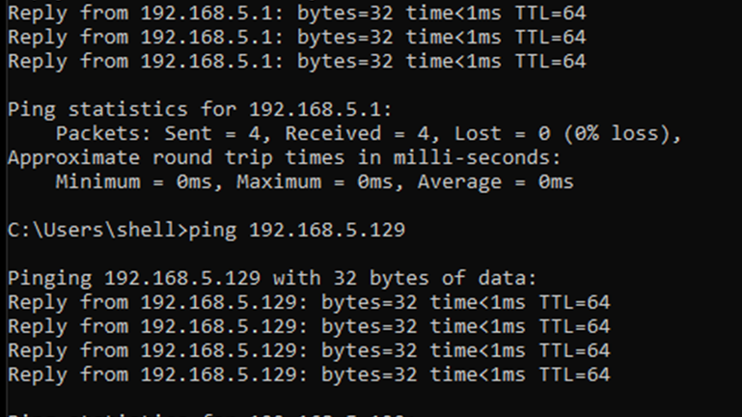
Successful Ping Tests:

Slide 41
Week 6 – WLAN Implementation
A WLAN’s SSID is its network name. It identifies a service set that refers to a collection of WIFI devices with the same parameters.
An SSID is case-sensitive and can be up to 32 characters long.
By default, wireless routers broadcast its SSID in short time intervals.
This enables WIFI clients to discover and join its network.

Slide 42
Creating an SSID:
This time Do Not activate airplane mode
Enter 192.168.105.1 and enter your password
Click on wireless and then modify
Enter new SSID NETW191 in the WIFI name (SSID) field. Enter your password and click apply to save.
Use your smartphone or tablet to discover SSID you just configured

Slide 43
List of SSID Names:

Slide 44
Connecting To The Network:

Slide 45
Connect to NETW191 network and check if your IP address is received. Enter your password.
Depending on your device you may need to click on properties under your SSID name or the SSID name itself.

Slide 46
WIFI Client IP Address:

Slide 47
Ping Test Your Device:
In the command prompt window perform a ping test to your device connected to your NETW191 network
Enter ping 192.168.105.136

Slide 48
Successful Ping Test

Slide 49
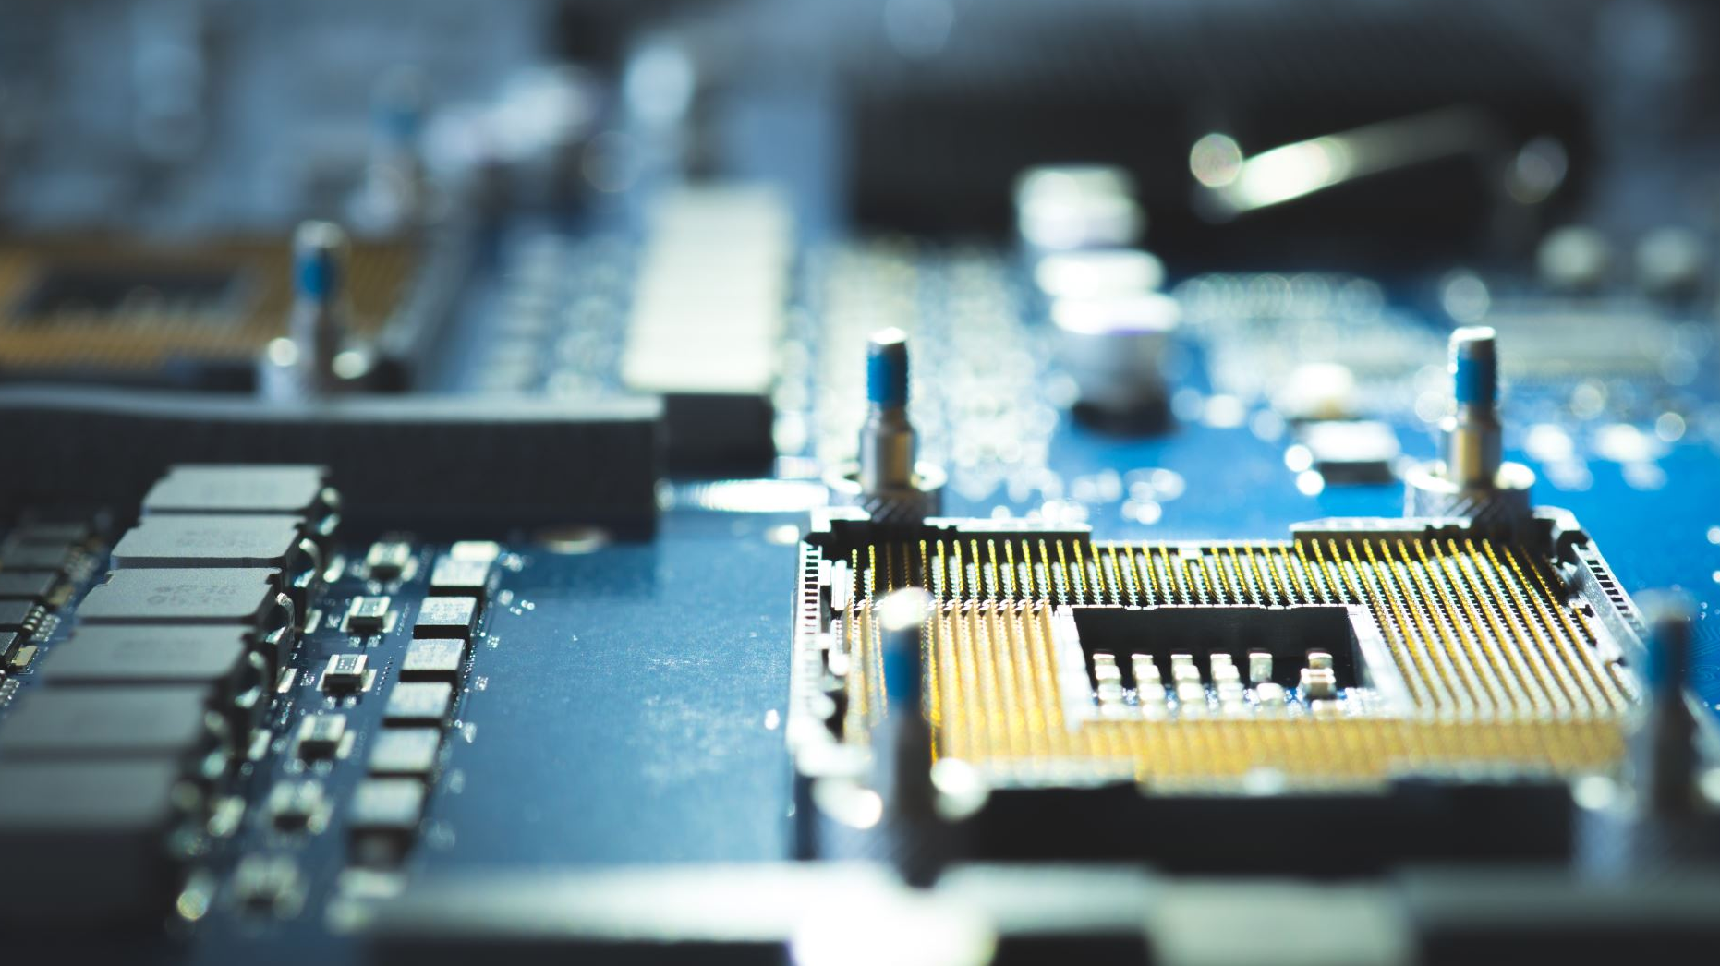
Troubleshooting:
The only issue I had was in Week 3. When I was trying to configure the IPv4 and IPv6 addresses. IPv4 address was successfully added but I could not get the IPv6 address to work and show up in the LAN.
After doing some research it turns out that the openwrt firmware for the travel router had been updated due to there being a bug in the older version of the travel router. So, I downloaded the upgrade in which the bug had been fixed in a bug report. I then had to manually enable the IPv6 settings and I was then able to successfully configure the IPv6.

