Slide 1
CEIS 106 Introduction to Operating Systems
By: Rashelle Stiltner
DeVry University

Slide 2
Week One: Installing Linux – Accessing BIOS
1. Research how to access the BIOS settings on your computer. What key or key combination or procedure do you use to access it?
Answer here: When I booted my computer, it did not automatically pull up the “Enter Setup” message. I had to pull up the Settings and click on Update and Security. Click on Recovery and then Restart now in Advanced Options. Then I had to click on UEFI Firmware Settings and Restart. When the window opened, I had to enable Virtualization Technology capabilities.
2. Do you have Virtualization or Virtualization Technology enabled in the BIOS settings of your computer?
Answer here: At first, it was disabled. Once I enabled Virtualization Technology it was smooth sailing.

Slide 3
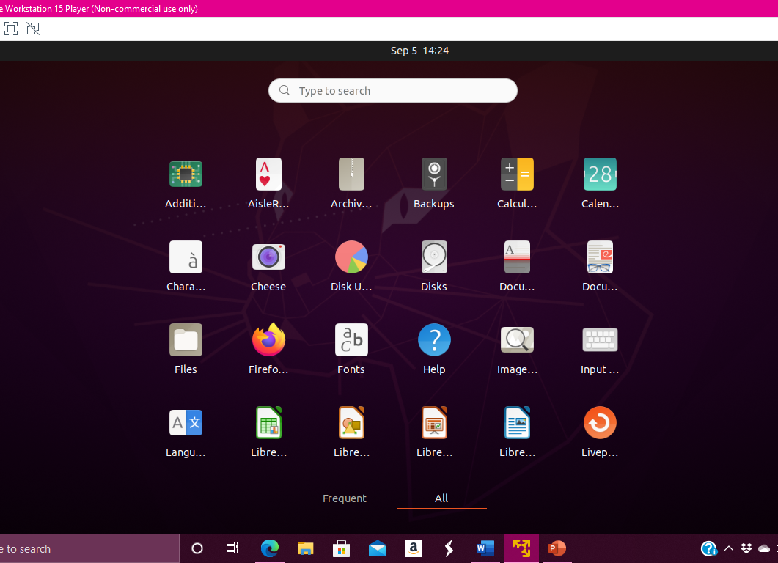
Successful Linux Installation
Once the Bios is enabled the instructions are easy to follow and setup is self explanatory.

Slide 4
Skills obtained this week:
How to setup and install Linux Kernel.
How to create a user account and the root account.
Also learned how to access the BIOS and enable functions if they aren’t automatically enabled.

Slide 5
Week Two – Linux Filesystems Hierarchy:
Skills learned this week:
Connecting the virtual machine to the internet
Navigating the Linux filesystem tree
How to create directories and files
Copying and removing directories and files
Locating directories and files

Slide 6
Connecting VM to Internet

Slide 7
Navigating Linux filesystem tree:
1. What is the pwd command an acronym for? What about the cd command?
Answer here:
pwd is an acronym for present working directory.
Cd is an acronym for current directory.
2. Explain the differences between a relative path and an absolute/full path in Linux.
Answer here:
An absolute path is a specific location of a file or directory from the root directory (/). It is complete path from the start of a file system from the root directory. A relative path is a file or directory relating to the present working directory (pwd). It is not derived directly from the root directory.

Slide 8
Creating directories and files:

Slide 9
Copying and removing directories and files:

Slide 10
Locating directories and files

Slide 11
Week 3 – Linux Shell scripts:

Slide 12
Creating a shell script:
1. What are the file permissions of the script?
Answer here: The file permissions of the script are: rwx-rwr-rrr. This is made available by running the ls –l command.
2. What’s the name of the user-defined variable in the script?
Answer here: The user defined variable is: “text”.
3. Which redirection meta-character is used in the script? What does it do?
Answer here: By entering ^x (CTRL + x) y this saves the script. Then by typing cat MyToDoList this brings up each script entry located within the file.

Slide 13
Changing script file permissions:

Slide 14
Setting the PATH variable:

Slide 15
Making the PATH variable permanent:

Slide 16
Running todolist in both windows:

Slide 17
Skills learned this week:
Creating a shell script
Changing the file permissions
How to set a PATH variable
Making the PATH variable permanent
Running the todolist

Slide 18
Adding users and groups in CLI:
1. What does the –m option in the useradd command do?
Answer here: The useradd command adds a new user to the home screen. By using the sudo useradd command assigns the user privileges as well.
2. What does the -3 option in the tail command do?
Answer here: The -3 option in the tail command displays the last three lines in the command of either the user specified. This is done by using the /etc/shadow in the tail command.
3. Which line of the /etc/group file lists members of the “students” group? Copy it here.
Answer here: Line 3: Students:x:1002:shellstiltner17, Mary.

Slide 19
Testing user and group settings:

Slide 20
Adding users in GUI:

Slide 21
Removing users and groups:

Slide 22
Skills obtained this week:
Adding users and groups in CLI
Testing user and group settings
Adding users in GUI
Removing users and groups

Slide 23
Week 5 – Network Configuration:

Slide 24
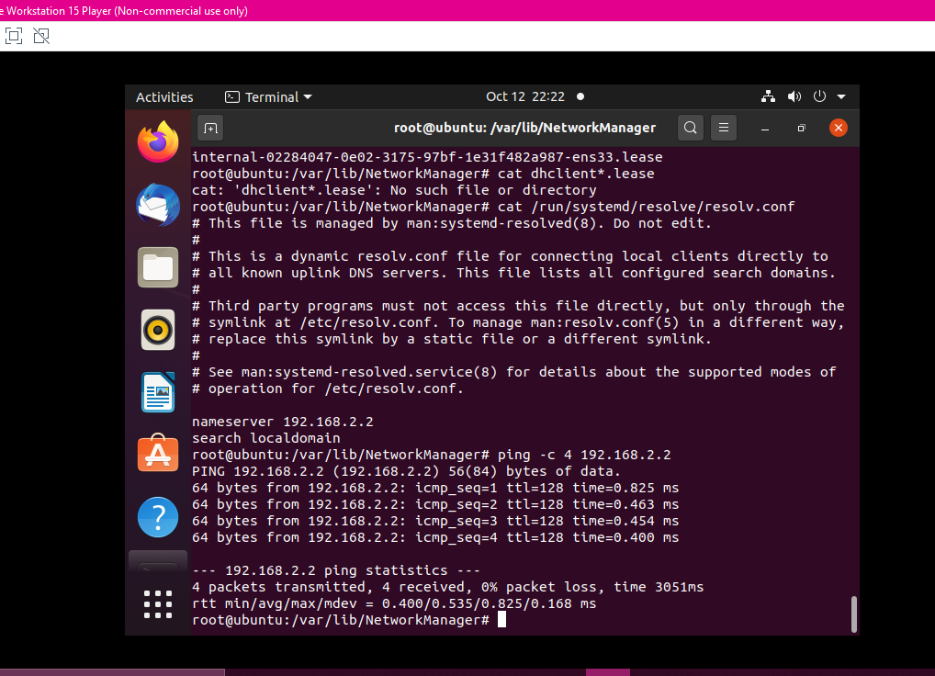
Discovering host IP configurations:
1. What is the IP address of your Ubuntu machine?
Answer here: 192.168.2.2
2. What is the IP address of its default gateway?
Answer here: 192.168.2.2
3. What is the IP address of its DHCP server?
Answer here: 192.168.2.2
4. What is the IP address of its DNS server?
Answer here: 192.168.2.2

Slide 25
Managing Network Interfaces:
1. Which DHCP message is shown in the output of the sudo dhclient –v –r ens33 command?
Answer here: DHCPRELEASE of 192.168.2.129 on ens33 to 192.168.2.254 port 67 (xid=0x4099f0ce)
2. Which four DHCP messages are shown in the output of the sudo dhclient –v ens33 command?
Answer here: DHCPDISCOVER on ens33 to 255.255.255.255 port 67 interval 3 (xid=0x61ad390e)
DHCPOFFER of 192.168.2.129 from 192.168.2.254
DHCPREQUEST for 192.168.2.129 on ens33 to 255.255.255.255 port 67 (xid=0xe39ad61)
DHCPACK of 192.168.2.129 from 192.168.2.254 (xid=0x61ad390e)

Slide 26
User Network Utilities:

Slide 27
Troubleshooting:
When entering the command: cd /var/lib/NetworkManager an error occurred stating that permission was denied.
To resolve this issue enter:
1). sudo –s to start a root shell and then cd into the directory
2). Once finished as root user, type exit and return to your home directory in the login shell.

Slide 28
Career Skills:
Everything I learned taking this course was all new to me for the most part. There were some things I knew about Linux like how to install and set up users and connect to the internet. There was a lot that I did not know such as how to copy and remove directories, navigating the filesystem tree, changing file script permissions, setting and making the PATH variable permanent and others. These will be extremely valuable in my career I wish to pursue in cyber security. I did very well on my practice Linux+ Certification exam. I am fairly confident that I will pass the Certification exam when I take it eventually.

